Slide 1
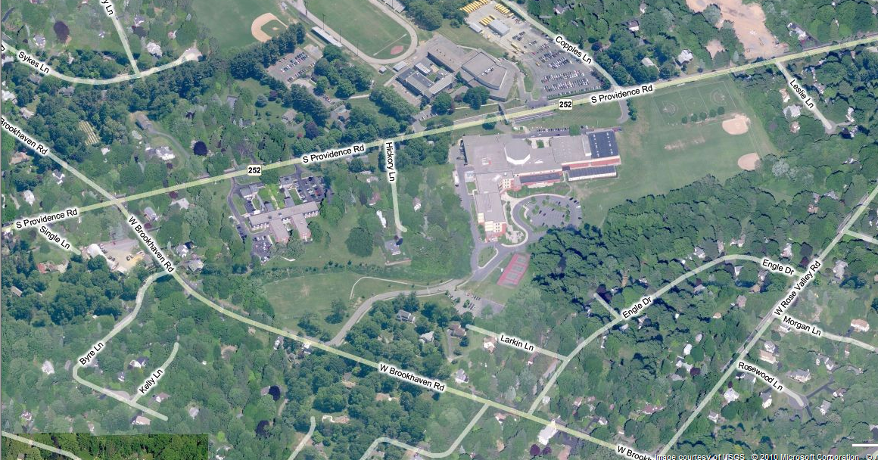
Name:_______________________________ Date:____________
Objective: Map the watershed for SHHS based on topography and a walk of the school grounds. Label and color code key features.
Identify the following:
Water Body 3. Land Uses
2. Divides 4. Storm Drains

