Slide 1
Phosphorus
ETHAN, KARA, MADELINE, MELINDA, BRIAN, COREY

Slide 3
Why do all living organisms require phosphorus to live?
In both producers and consumers, phosphorus is a component of biologically important molecules such as nucleic acids and energy transfer molecules (ADP and ATP)

Slide 4
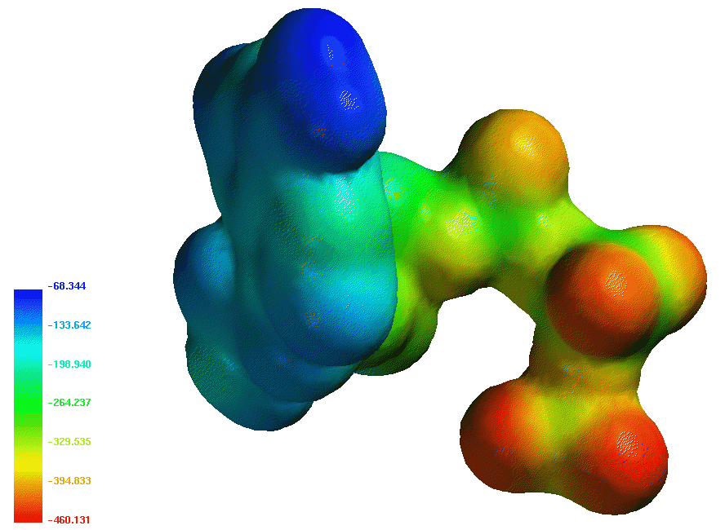
What specific life processes use phosphorus in their chemical reactions?
ATP= Adenosine Triphosphate is enhanced during physical activity

Slide 5
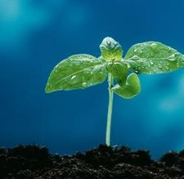
How do plants obtain the phosphorus they need?
Plants obtain phosphorus from soil, but soil contains little phosphorus. Phosphorus is applied to the soil as inorganic fertilizer

Slide 6
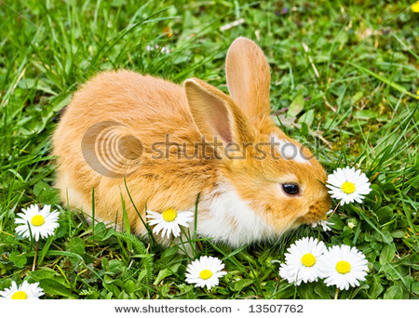
How do animals obtain the phosphorus they need?
Animals obtain the phosphorus that they need from eating plants that contain phosphorus sources.

Slide 7
In what ways do humans rely on phosphorus?
We rely of phosphorus to make inorganic fertilizer and reducing phosphorus in tropical soils by clearing forests

Slide 8
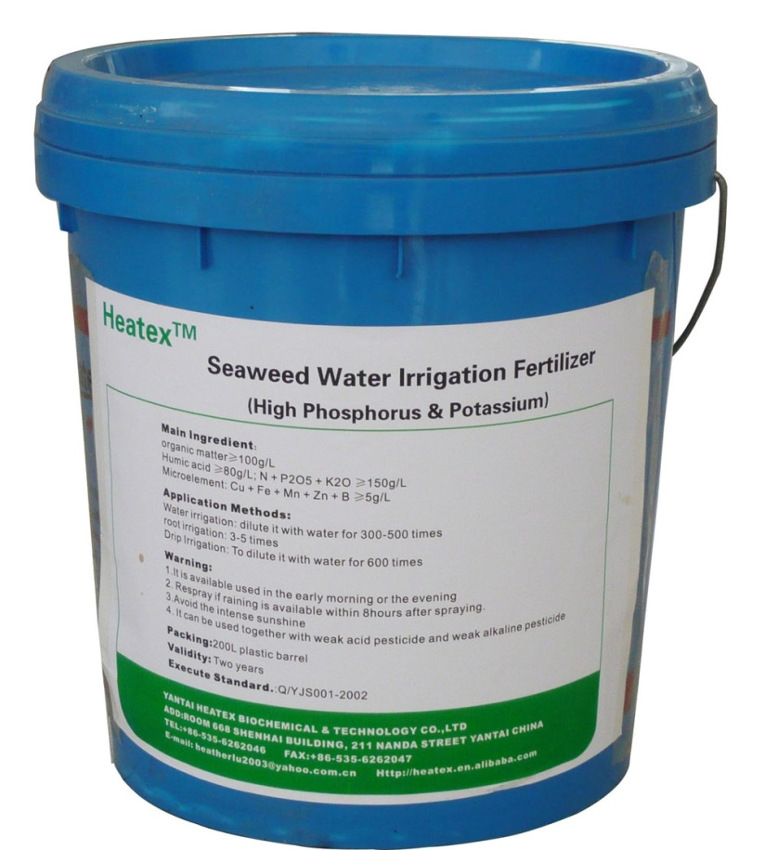
How do humans adversely affect the phosphorus cycle?
Humans remove phosphorus from the earth to make fertilizer and that depletes the phosphorus

Slide 9
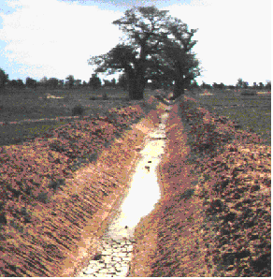
How do humans adversely affect the phosphorus cycle?
When we fertilize crop fields, soil that is eroded carries large quantities of phosphate into streams, lakes, and the ocean, where is stimulates the growth of producers

