Slide 1
Homework and Lab Expectations
Biology CP

Slide 2
All work should be as neat as possible
I appreciate your artistic talent, but please, no doodles
Lab worksheets must be labeled and filled out correctly
Study guide sheets must have corrections made on them in a different color ink or pencil

Slide 3
Lab reports must be typed and handed in as a hard copy
Specified Homework should be handed in on the day of the test with a cover page

Slide 4
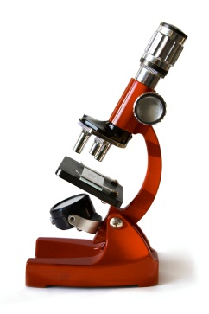
Sample Cover
Title
Chapter 1 Homework
Graphic representing a topic covered
Name
Block
Full Name and Block

Slide 5
Grade Breakdown
40 % Tests
40% Lab (Written Reports Only) and Projects
20% Lab (Class Activities, Homework, and Quizzes (Latin Roots)

